Slide 1

Realtime Data
Basic Information: - Firmware & software version - Connected network (WIFI / Ethernet) - IP & MAC Address
Actions History: - Successful authentications - Failed authentications - Usage frequency - Cylinder lock / unlock status
Authorization Info: - Allowed fingerprints / key serial IDs - Authenticate methods: Eg. Fingerprint necessary / unnecessary
Remote operations: - Add authorized key by a fingerprint hash / serial ID - Lock / Unlock - Enable / Disable beeper (silent mode)

Slide 2
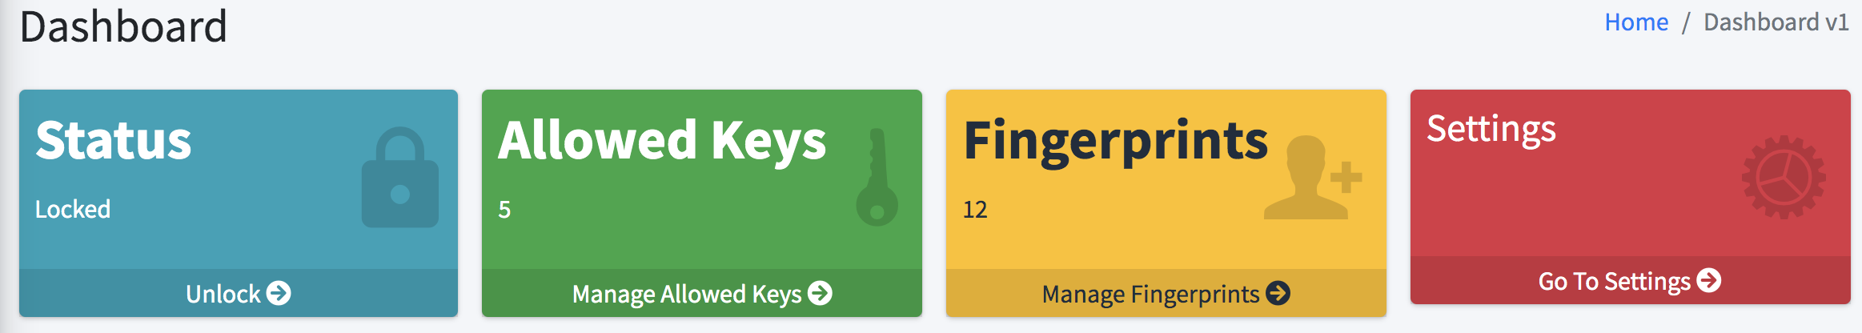
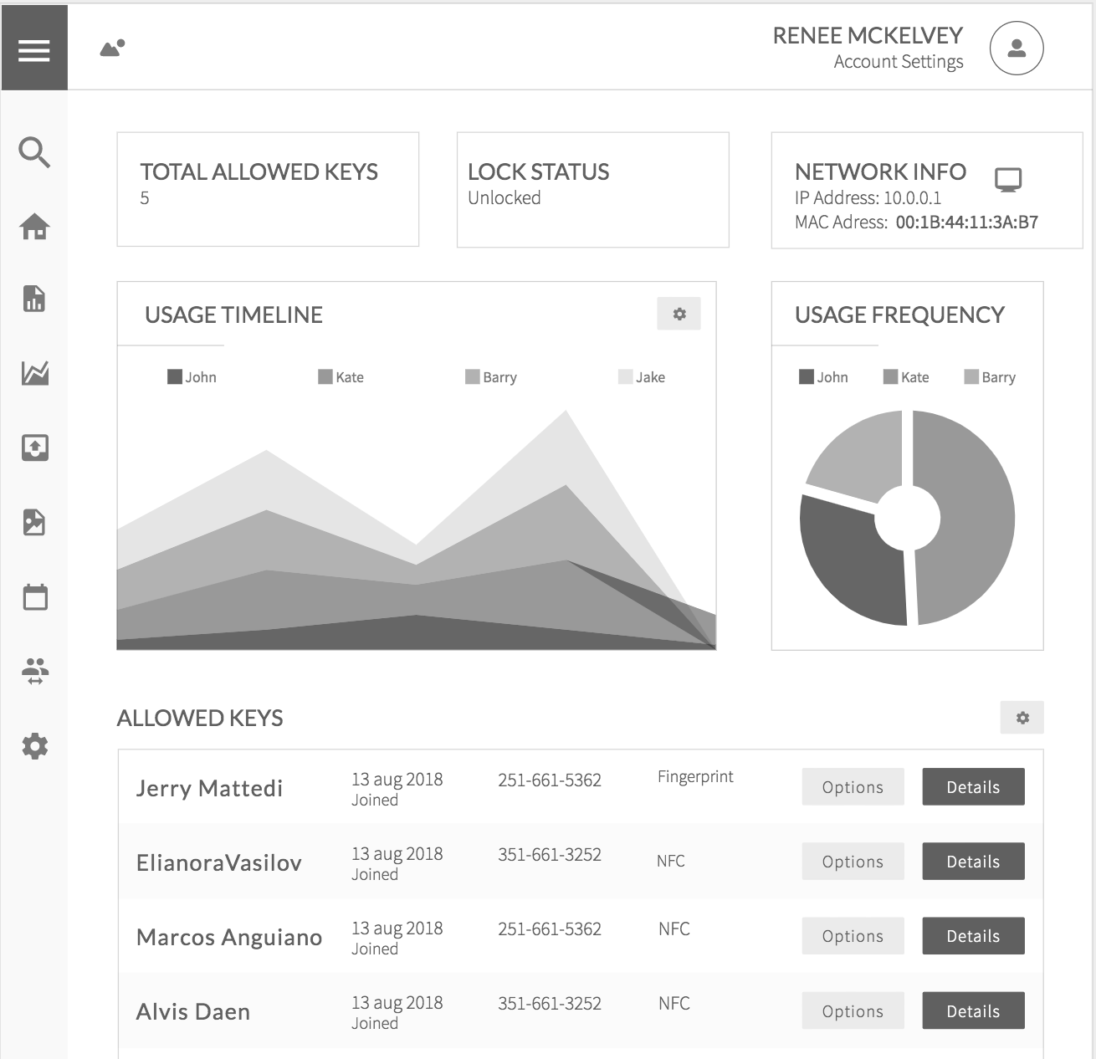
Client Analysis

Slide 3
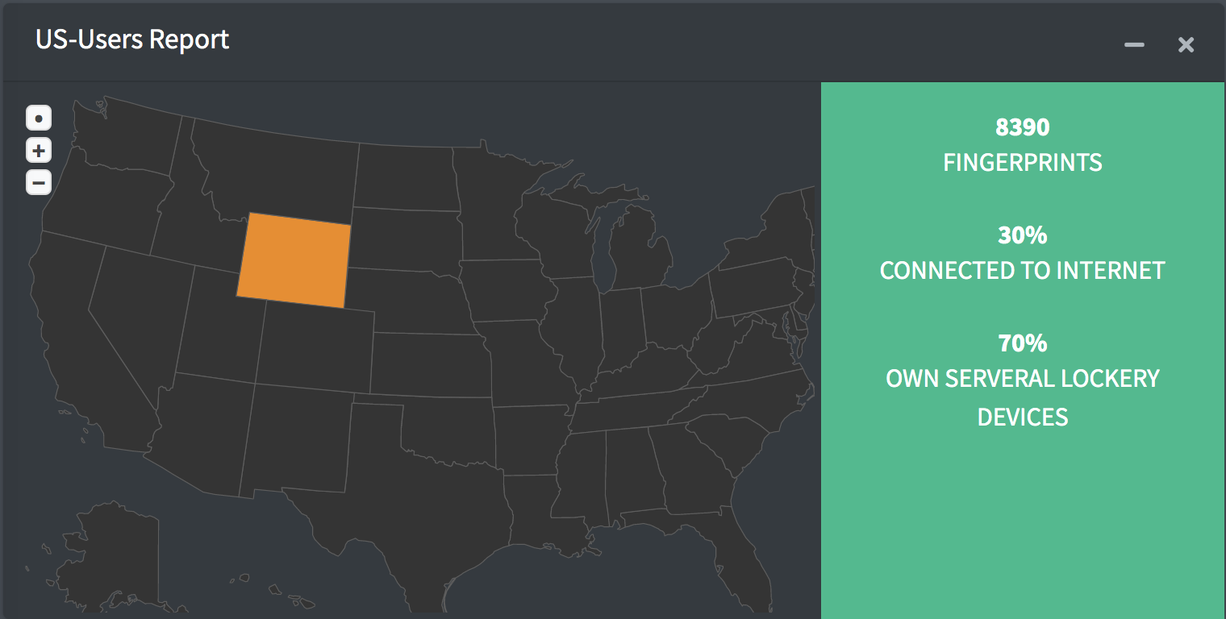
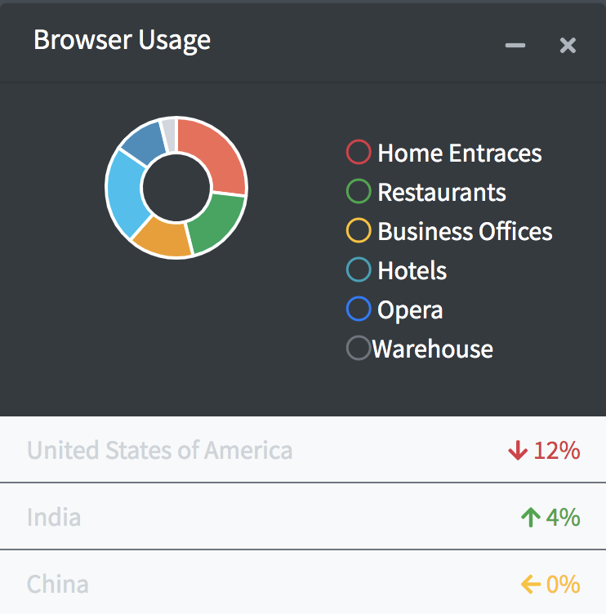
3rd Party Analysis

